Slide 1

Internet of Things (IoT)

Slide 2
Outline
Introduction to IoT
Enabling technologies
Open problems and future challenges
Applica1ons
2

Slide 3
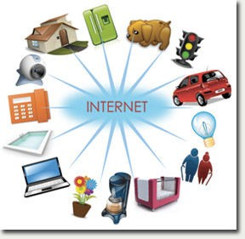
What is IoT?
A phenomenon which connects a variety of things
– Everything that has the ability to communicate
3

Slide 4
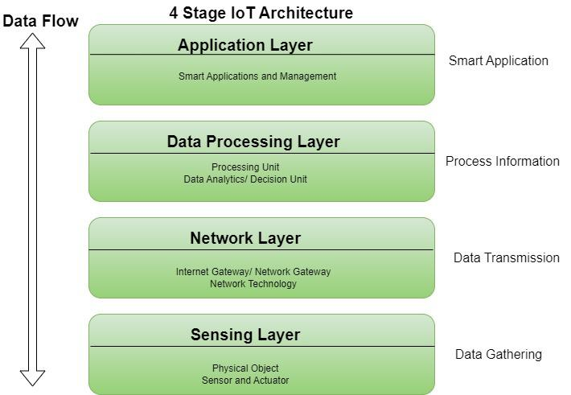

Slide 5
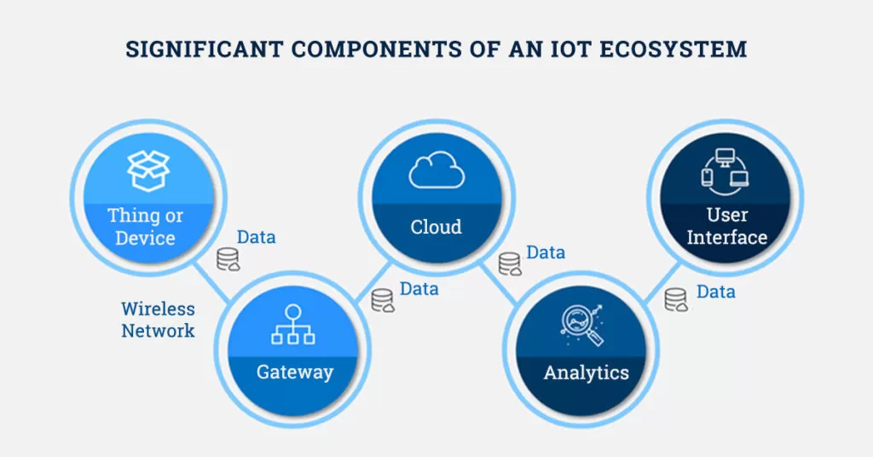

Slide 6
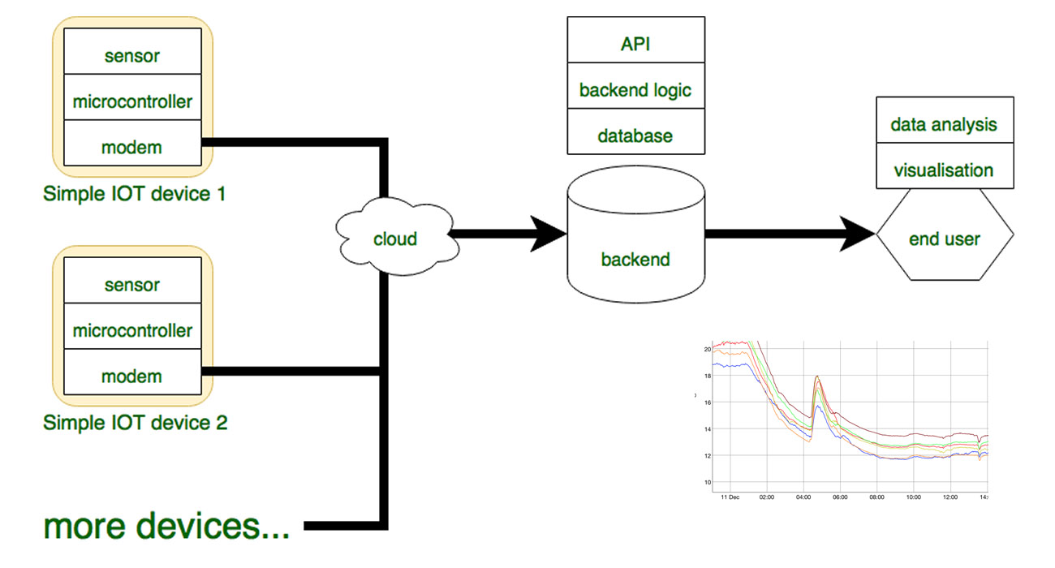

Slide 7
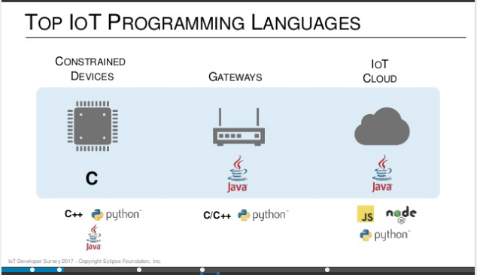

Slide 8
IoT Deﬁni1ons
The Internet of Things, also called The Internet of Objects, refers to a wireless network between objects, usually the network will be wireless and self‐conﬁguring, such as household appliances. (Wikipedia)
The term "Internet of Things" has come to describe a number of technologies and research disciplines that enable the Internet to reach out into the real world of physical objects. (IoT 2008)
“Things having iden11es and virtual personali1es opera1ng in smart spaces using intelligent interfaces to connect and communicate within social, environmental, and user contexts”. (IoT in 2020)
5

Slide 9
Characteris1cs of IoT
Intelligence
Knowledge extrac1on from the generated data
Architecture
A hybrid architecture suppor1ng many others
Complex system
A diverse set of dynamically changing objects
Size considera1ons
Scalability
Time considera1ons
Billions of parallel and simultaneous events
Space considera1ons
Localiza1on
Everything‐as‐a‐service
Consuming resources as a service
8

Slide 10

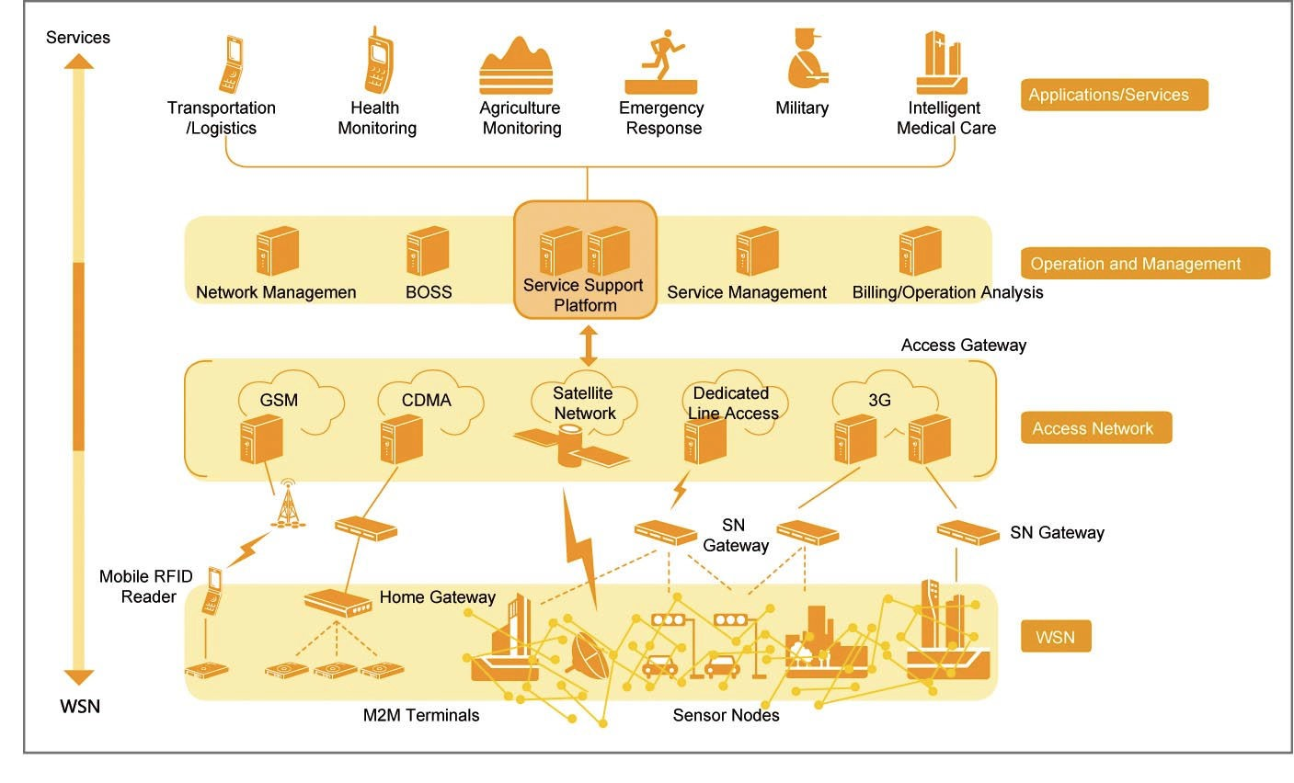



IoT Layered Architecture
Middleware and Applica>ons
Sensing And Communica>on
Source: ZTE
9

Slide 11
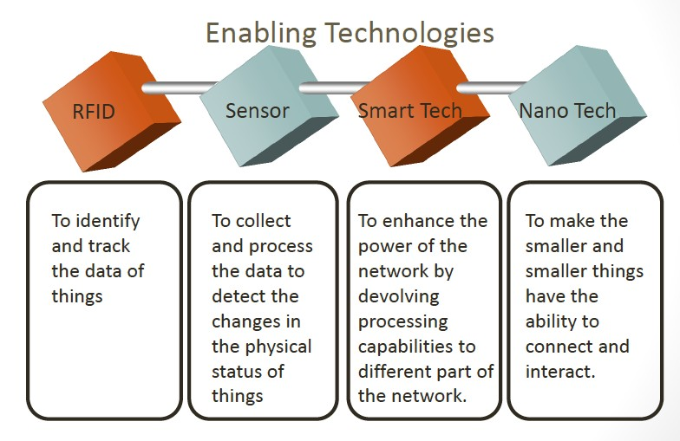
Networking and Communica1on
RFID to smallest enabling technologies, such as chips, etc.
Source: Qian Zhang. Lecture notes. 2013
10

Slide 12
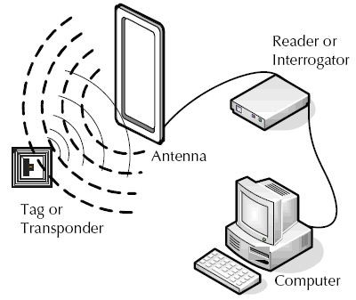
RFIDs
The reduc1on in terms of size, weight, energy consump1on, and cost of the radio takes us to a new era
– This allows us to integrate radios in almost all objects and thus, to add the world ‘‘anything” to the above vision which leads to the IoT concept
Composed of one or more readers and tags
RFID tag is a small microchip a`ached to an antenna
Can be seen as one of the main, smallest
components of IoT, that collects data
11

Slide 13
Wireless Technologies
Telecommunica1on systems
Ini1al/primary service: mobile voice telephony
Large coverage per access point (100s of meters – 10s of kilometers)
Low/moderate data rate (10s of kbit/s – 10s of Mbits/s)
Examples: GSM, UMTS, LTE(4G/5G Long term Evaluation)
WLAN
Ini1al service: Wireless Ethernet extension
Moderate coverage per access point (10s – 100s meters)
Moderate/high data rate (Mbits/s – 100s)
Examples: IEEE 802.11(a‐g), Wimax
Source: Geert Heijenk. Mobile and Wireless Networking. Lecture Notes. 2014
12

Slide 14
Wireless Technologies
Short range:
Direct connec1on between devices – sensor networks
Typical low power usage
Examples: Bluetooth, Zigbee, Z‐wave (house products)
Other examples:
Satellite systems
Global coverage
Applica1ons: audio/TV broadcast, posi1oning, personal communica1ons
Broadcast systems
Satellite/terrestrial
Support for high speed mobiles
Fixed wireless access
Several technologies including DECT, WLAN, IEEE802.16, etc.
Source: Geert Heijenk. Mobile and Wireless Networking. Lecture Notes. 2014
13

Slide 15
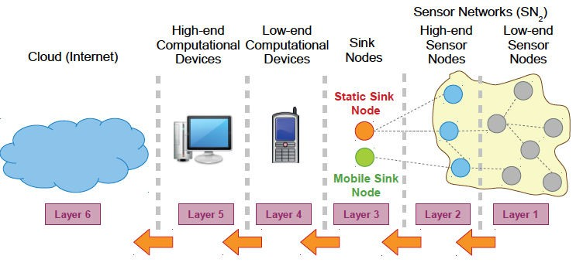
Sensor Networks (SNs)
Consist of a certain number (which can be very high) of sensing nodes (generally wireless) communica1ng in a wireless mul1‐hop fashion
Source: Perera et al. 2014
14

Slide 16
Sensor Networks (SNs)
SNs generally exist without IoT but IoT cannot exist without SNs
SNs have been designed, developed, and used for speciﬁc applica1on purposes
Environmental monitoring, agriculture, medical care, event detec1on etc.
For IoT purposes, SNs need to have a middleware addressing these issues:
Abstrac1on support, data fusion, resource constraints, dynamic topology, applica1on knowledge, programming paradigm, adaptability, scalability, security, and QoS support
15

Slide 17
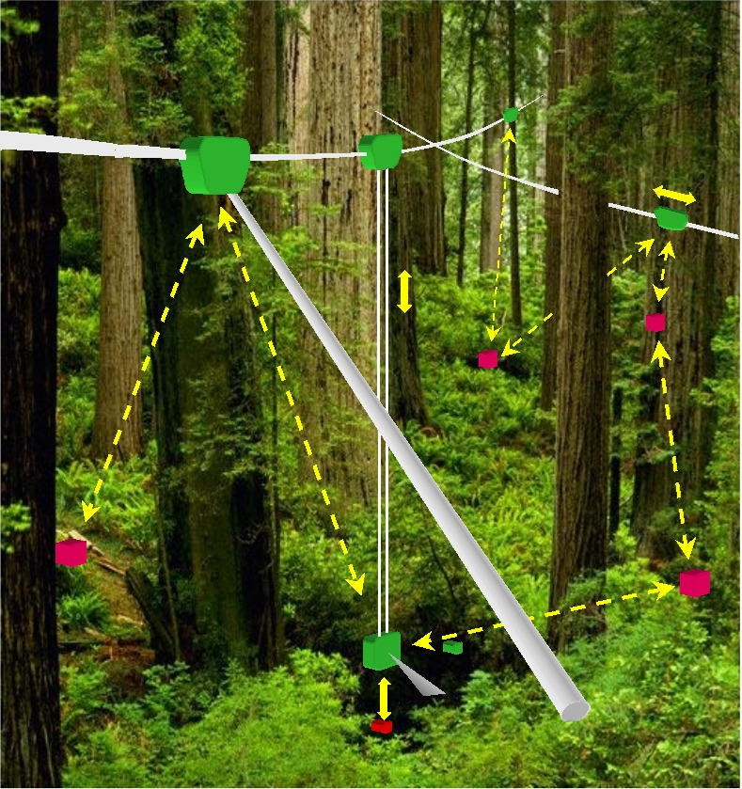
Networked Infomechanical Systems (NIMS)
Networked mobile nodes
Sensing
Sampling
Energy logistics
Communication
Infrastructure
Deterministic and precise motion
3-D volume access
Mass transport at low energy
System Ecology for Sustainability
Fixed nodes
Mobile nodes
Infrastructure

Slide 18
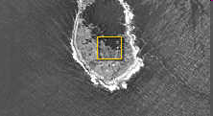
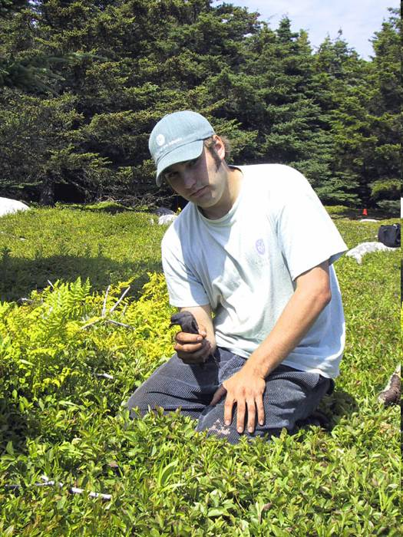
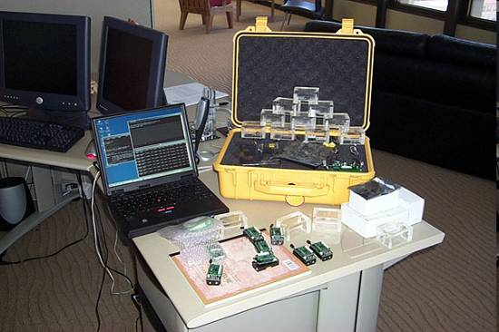
Habitat Monitoring on Great Duck Island
http://www.greatduckisland.net/
Intel Research Laboratory at Berkeley initiated a collaboration with the College of the Atlantic in Bar Harbor and the University of California at Berkeley to deploy wireless sensor networks on Great Duck Island, Maine (in 2002)
Monitor the microclimates in and around nesting burrows used by the Leach's Storm Petrel
Goal : habitat monitoring kit for researchers worldwide

Slide 19
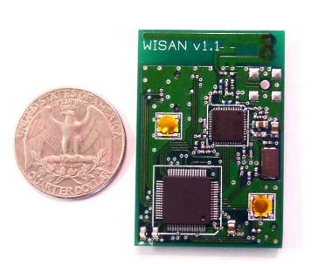
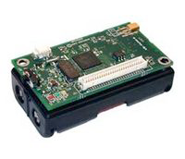
Sensor Nodes
Worldsens Inc. Sensor Node
Crossbow Sensor Node

Slide 20
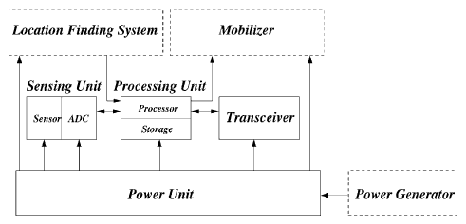
Sensor Node Components

Slide 21
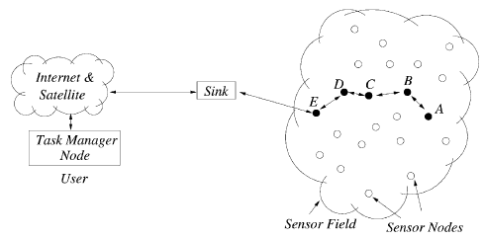
WSN Communication Architecture

Slide 22
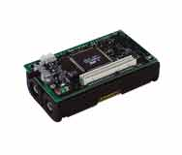
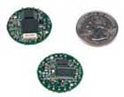
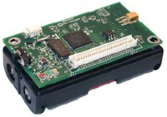
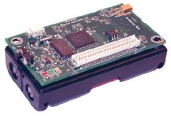
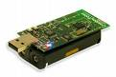
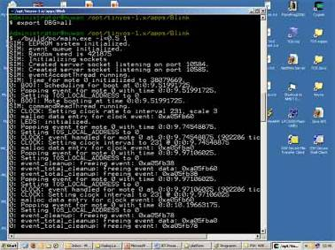

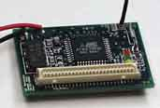
Different Targets
mica | mica2 | mica2dot | micaz
telos | telosb | rene2 | pc

Slide 23
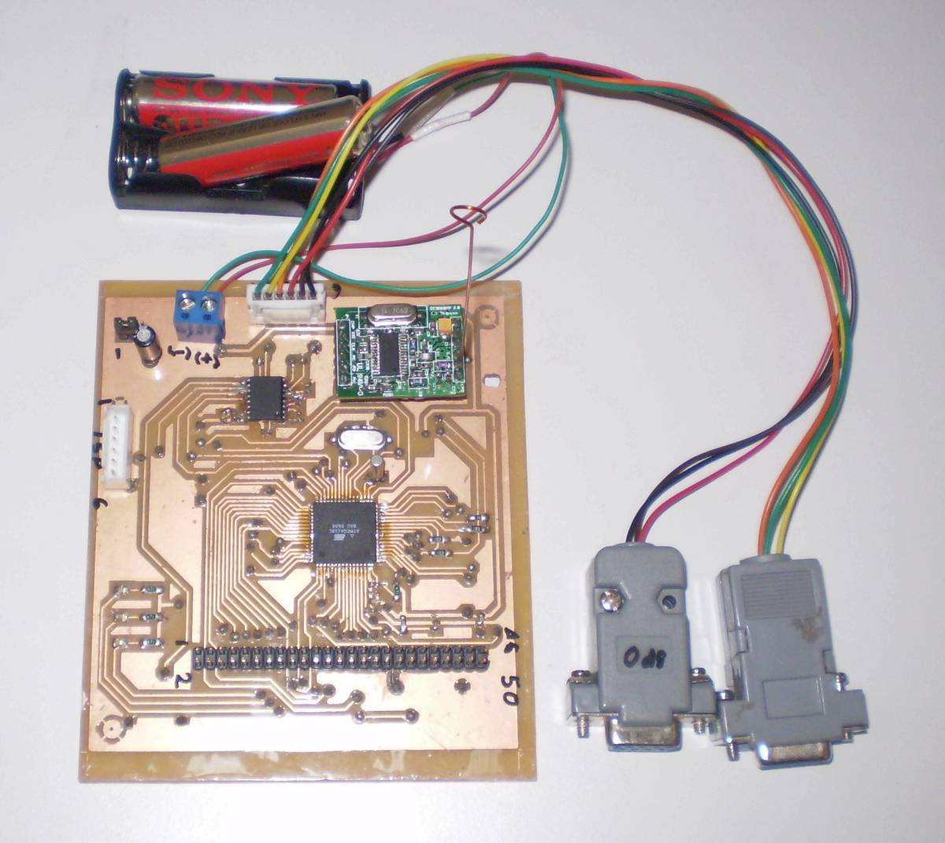
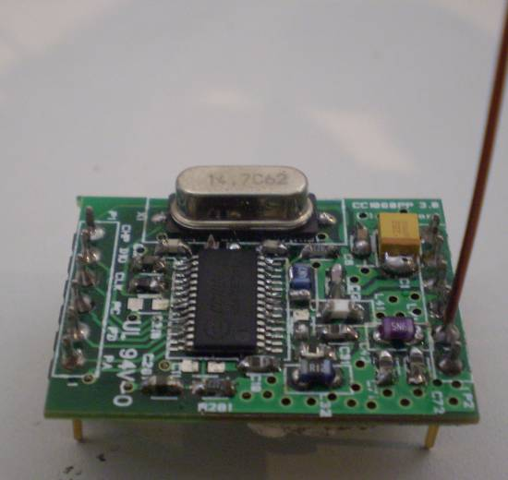
Mica2 Clone

Slide 24
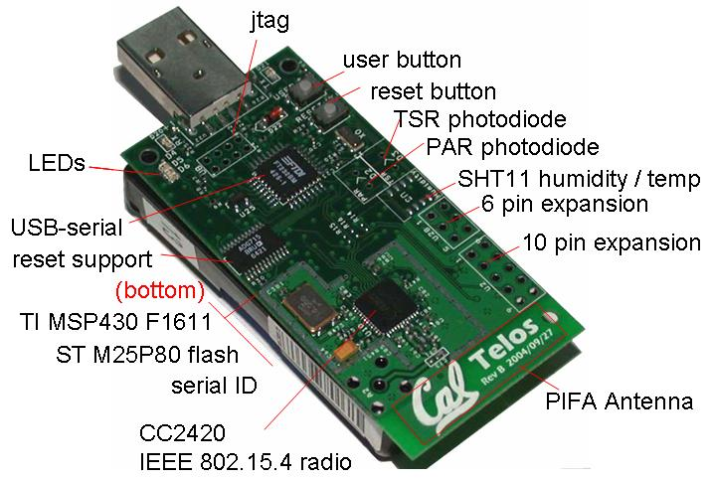
TELOSB MOTE
Ref:http://www.eecs.berkeley.edu/~culler/eecs194/labs/lab1/telosb.JPG

Slide 25
One Example Sensor Board - MTS310

Slide 26
WSN Simulators
NS-2
GloMoSim
OPNET
SensorSim
J-Sim
OMNeT++
Sidh
SENS

Slide 27
WSN Emulators
TOSSIM
ATEMU
Avrora
EmStar

Slide 28
Example: Indoor Localiza1on
An indoor positioning system (IPS) is a solution to locate objects or people inside a building using radio waves, magnetic fields, acoustic signals, or other sensory information collected by mobile devices.
For indoor localization:
Any wireless technology can be used for locating
GPS, WiFi, Bluetooth, RFID, Ultrawide band, Infrared, Visible light communication, Ultrasound
16

Slide 29
Middleware
Middleware is a so/ware layer that stands between the networked opera4ng system and the applica4on and provides well known reusable solu4ons to frequently encountered problems like heterogeneity, interoperability, security, dependability [Issarny, 2008]
IoT requires stable and scalable middleware solu1ons to process the data coming from the networking layers
17

Slide 30
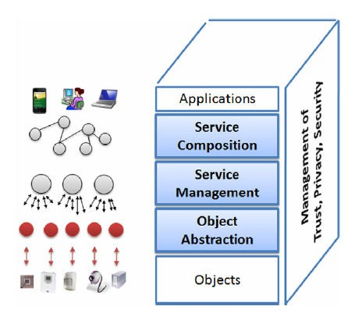
Service Oriented Architecture (SOA)
Middleware solu1ons for IoT usually follow SOA approaches
Allows SW/HW reuse
Doesn’t impose speciﬁc technology
A layered system model addressing previous issues
Abstrac1on, common
Source: Atzori et al. 2010
services, composi1on
18

Slide 31
Other Middleware Examples
Fosstrak Project
Data dissemina1on/aggrega1on/ﬁltering/interpreta1on
Fault and conﬁgura1on management, lookup and directory service, tag ID management, privacy
Welbourne et al.
Tag an object/create‐edit loca1on info/combine events collected by antennas
e‐Sense Project
Middleware only collects data in a distributed fashion and transmits to actuators
UbiSec&Sens Project
Focuses on security → secure data collec1on, data store in
memory, etc.
19

Slide 32
Open Problems and Challenges
Lack of standardiza1on
Scalability
Addressing issues
Understanding the big data
Support for mobility
Address acquisi1on
New network traﬃc pa`erns to handle
Security/Privacy issues
20

Slide 33
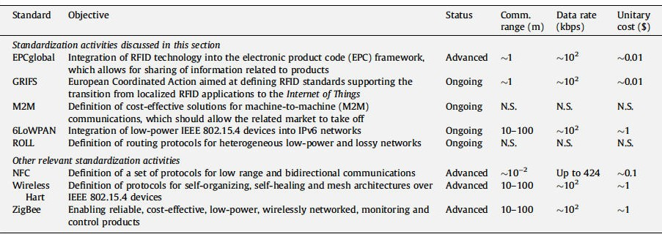
Standardiza1on
Several standardiza1on eﬀorts but not integrated in a comprehensive framework
Open Interconnect Consor1um: Atmell, Dell, Intel, Samsung and Wind River
Industrial Internet Consor1um: Intel, Cisco, GE, IBM
AllSeen Alliance: Led by Qualcomm, many others
21

Slide 34
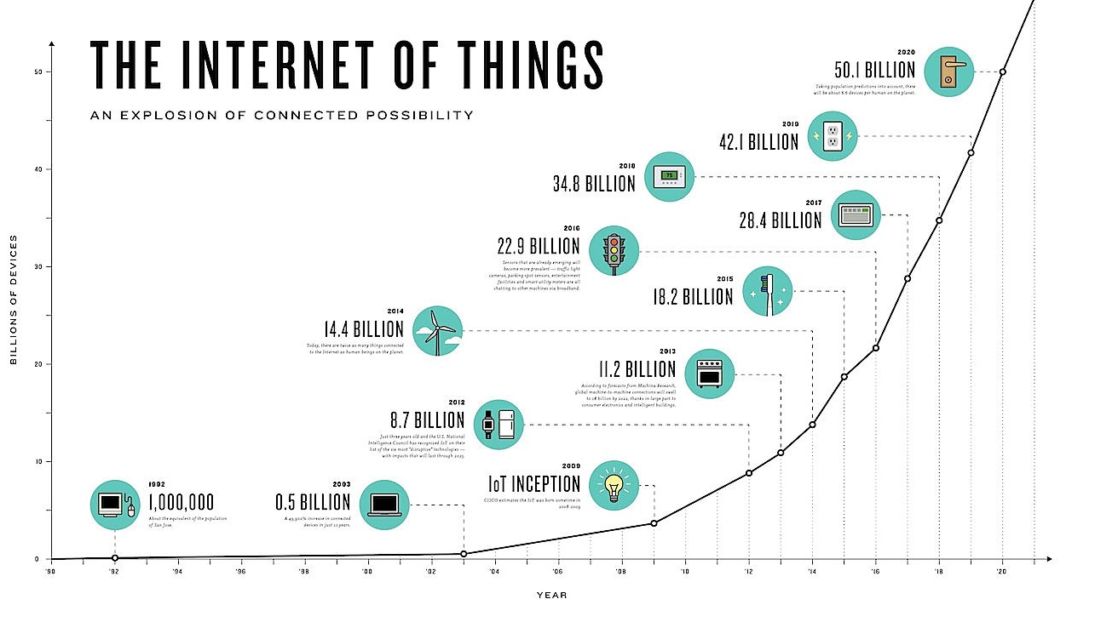
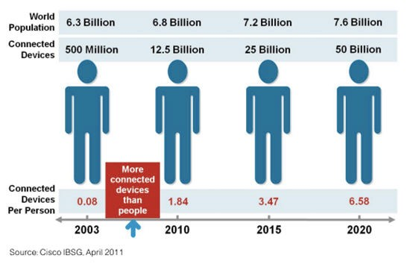
Scalability
Number of devices increasing exponen1ally
How can they uniquely be tagged/named?
How can the data generated by these devices be managed?
22

Slide 35
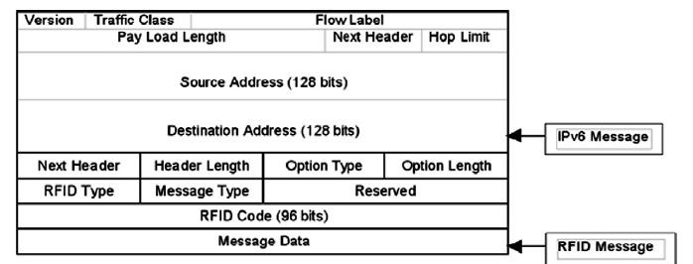
Addressing Issues
Incredibly high number of nodes, each of which will produce content that should be retrievable by any authorized user
This requires eﬀec1ve addressing policies
IPv4 protocol may already reached its limit. Alterna1ves?
IPv6 addressing has been proposed for low‐power wireless communica1on nodes within the 6LoWPAN context
IPv6 addresses are expressed by means of 128 bits →1038 addresses, enough to iden1fy objects worth to be addressed
RFID tags use 64–96 bit iden1ﬁers, as standardized by EPCglobal, solu1ons to enable the addressing of RFID tags into IPv6 networks
Encapsulation of RFID message into an IPv6 packet.
23

Slide 36
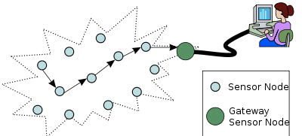
New Traﬃc to Handle
The characteris1cs of the smart objects traﬃc in the IoT is s1ll not known
Important → basis for the design of the network infrastructures and protocols
Wireless sensor networks (WSNs) traﬃc characteriza1on
Strongly depend on the applica1on scenario
Problems arise when WSNs become part of the overall Internet
The Internet will be traversed by a large amount of data generated by sensor networks deployed for heterogeneous purposes → extremely diﬀerent traﬃc characteris1cs
Required to devise good solu1ons for suppor1ng quality of service
24

Slide 37
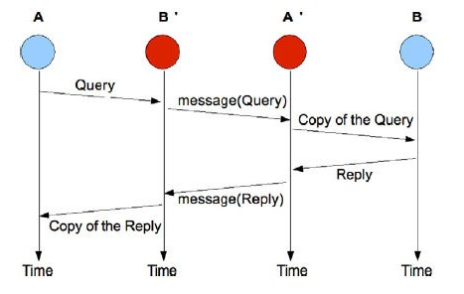
Security
The components spend most of the 1me una`ended
It is easy to physically a`ack them
IoT components are characterized by low capabili1es in terms of both energy and compu1ng resources
They can’t implement complex schemes suppor1ng security
Authen1ca1on problem
Proxy a`ack, a.k.a. man in the middle a`ack problem
Data integrity
Data should not be modiﬁed without the system detec1ng it
A`acks on the node
Memory protec1on
A`acks over the network
Keyed‐Hash Message Auth. Code
Man in the middle attack Source: Atzori et al. (2010)
25

Slide 38
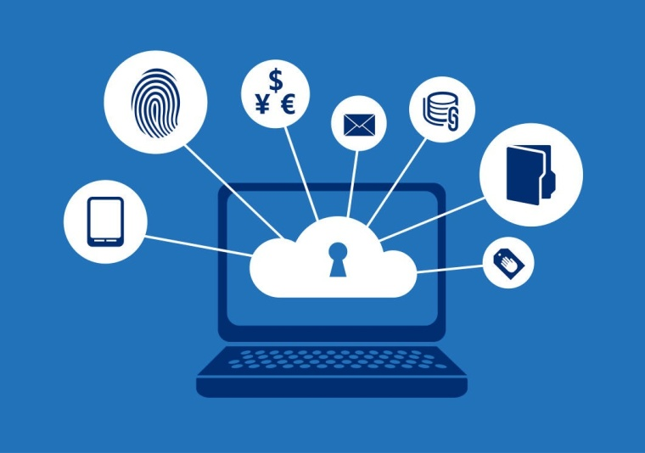
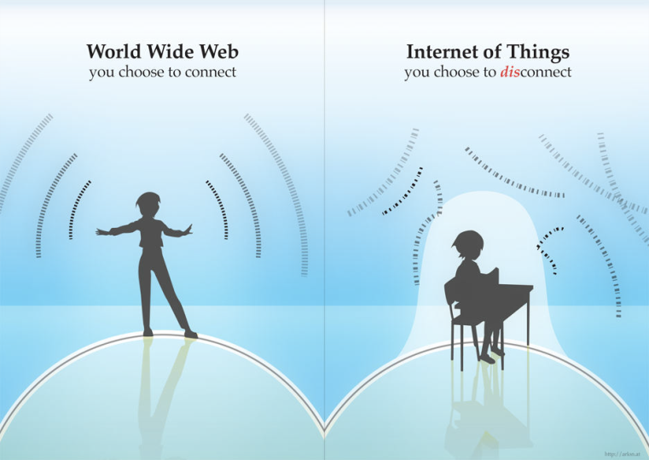
Privacy
How is it diﬀerent than tradi1onal privacy?
Legisla1ve issues
Ethics issues
Easy for a person to get involved in IoT even if he/she does not know
Data can be stored indeﬁnitely
Current solu1ons are not enough
Encryp1on, pseudo‐noise signal, privacy broker
26

Slide 39
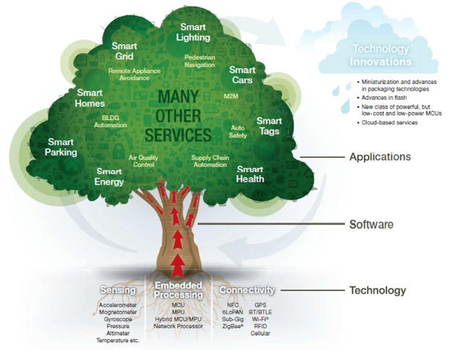
Again ‐ Overall Picture
Source: “What the Internet of Things (IoT) Needs to Become a Reality,” White Paper, by K. Karimi and G. Atkinson
27

Slide 40
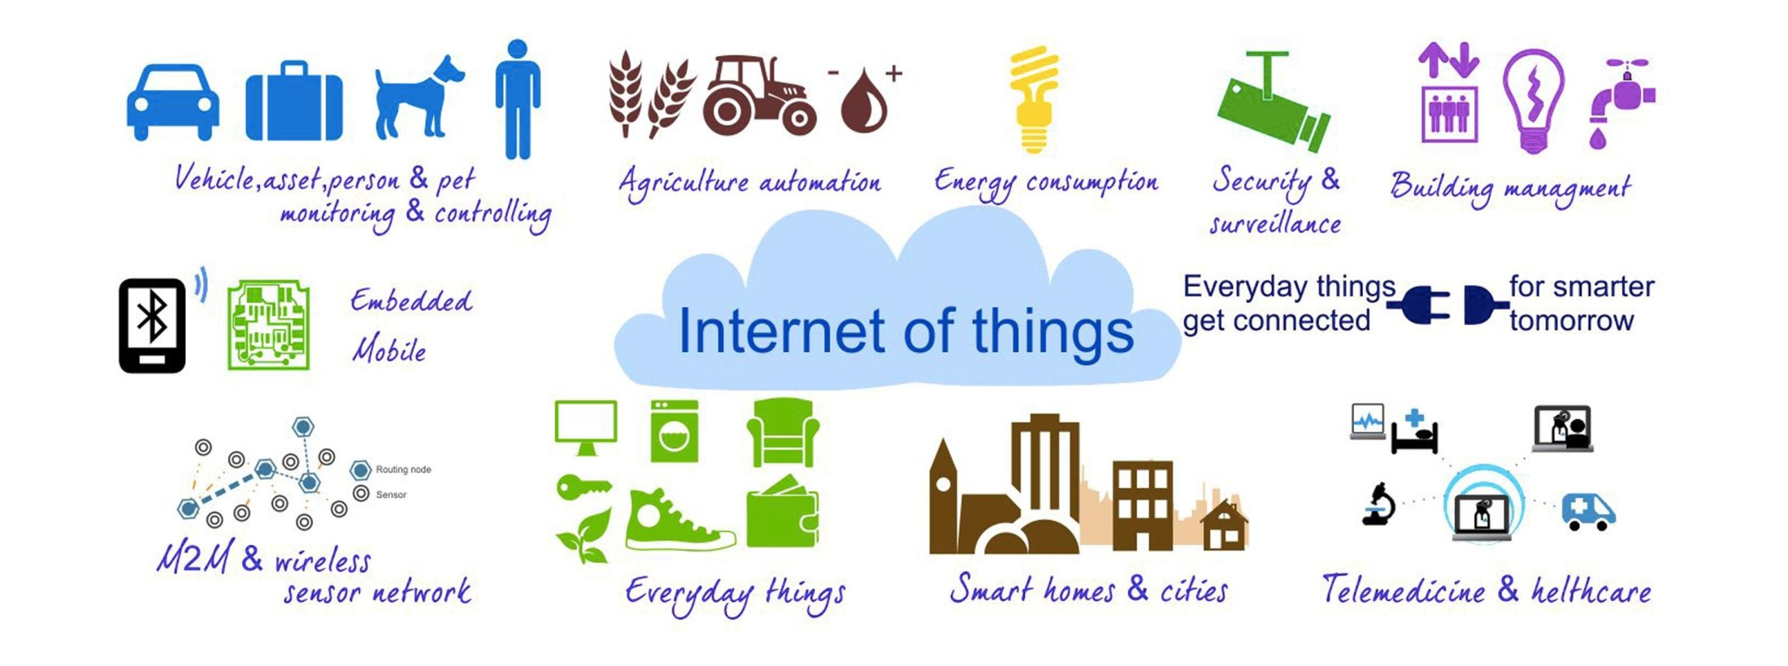
Applica1ons
Several diﬀerent domains
Transporta1on and logis1cs
Healthcare
Smart environment (home, oﬃce, etc.)
Personal and social domain
28

Slide 41
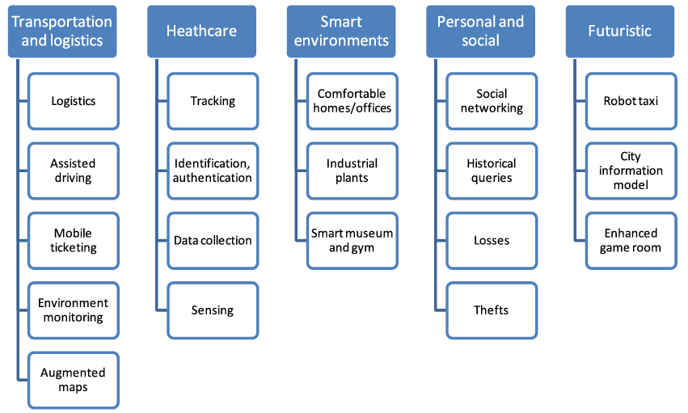
Applica1on Domains and Scenarios
29

Slide 42
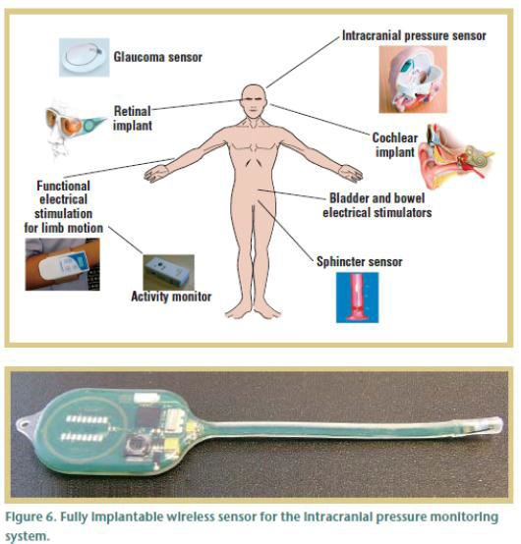
Healthcare Applica1ons
Various sensors for various condi1ons
Example ICP sensor: Short or long term monitoring of pressure in the brain cavity
Implanted in the brain cavity and senses the increase of pressure
Sensor and associated electronics encapsulated in safe and biodegradable material
External RF reader powers the unit and receives the signal
Stability over 30 days so far 30

Slide 43
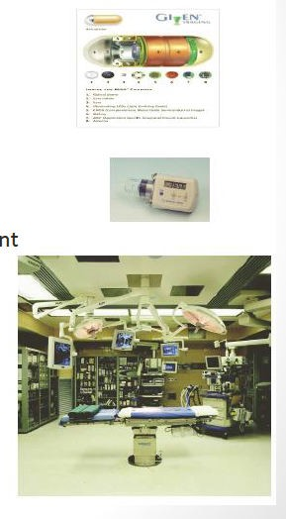
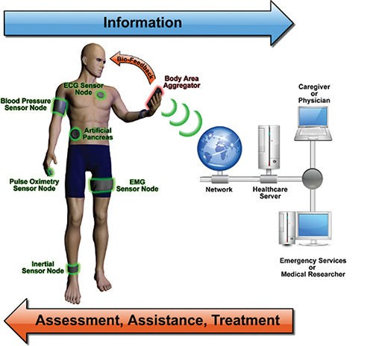
Healthcare Applica1ons
Other applica1ons:
Na1onal Health Informa1on Network
Electronic Pa1ent Record
Home monitoring and control
Pulse oximeters, blood glucose monitors, infusion pumps, accelerometers
Bioinforma1cs
Gene/protein expression
Systems biology
Disease dynamics
31

Slide 44
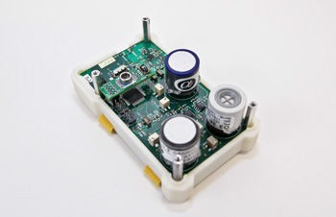
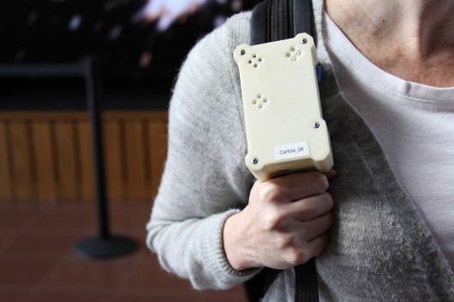
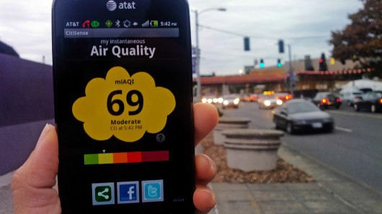
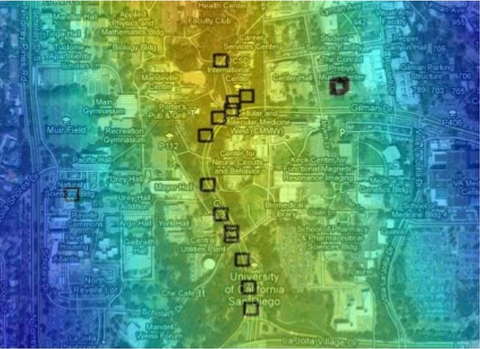
Environmental Applica1on: Ci1Sense
Air quality monitoring project in UCSD CSE
Environmental applica1on
Electrochemical sensors, microcontroller for data collec1on and transmission to an Android app
Actua>on: air quality is immediately reported, as well as retransmi`ed to a backend for larger‐scale analysis
32

Slide 45
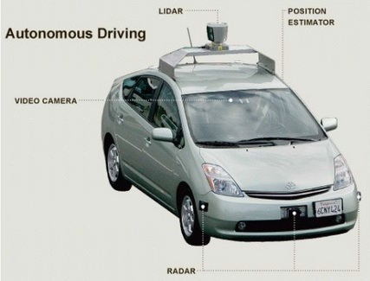
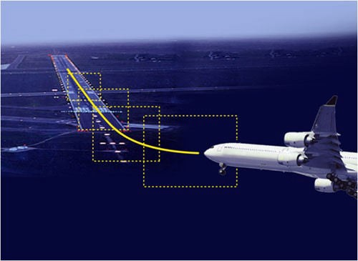
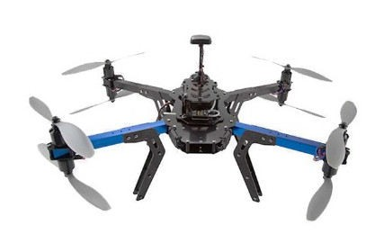
Transporta1on Applica1ons
Vehicle control: Airplanes, automobiles, autonomous vehicles
All kinds of sensors to provide accurate, redundant view of the world
Several processors in cars (Engine control, break system, airbag deployment system, windshield wiper, door locks, entertainment system, etc.)
Actua1on is maintaining control of the vehicle
Very 1ght 1ming constraints and requirements enforced by the plarorms
33

Slide 46
Example Transporta1on Scenarios
A network of sensors in a vehicle can interact with its surroundings to provide informa1on
Local roads, weather and traﬃc condi1ons to the car driver
Adap1ve drive systems to respond accordingly
Automa1c ac1va1on of braking systems or speed control via fuel management systems.
Condi1on and event detec1on sensors can ac1vate systems to maintain driver and passenger comfort and safety through the use of airbags and seatbelt pre‐tensioning
Sensors for fa1gue and mood monitoring based on driving condi1ons, driver behavior and facial indicators
Ensuring safe driving by ac1va1ng warning systems or directly controlling the vehicle
34

Slide 47
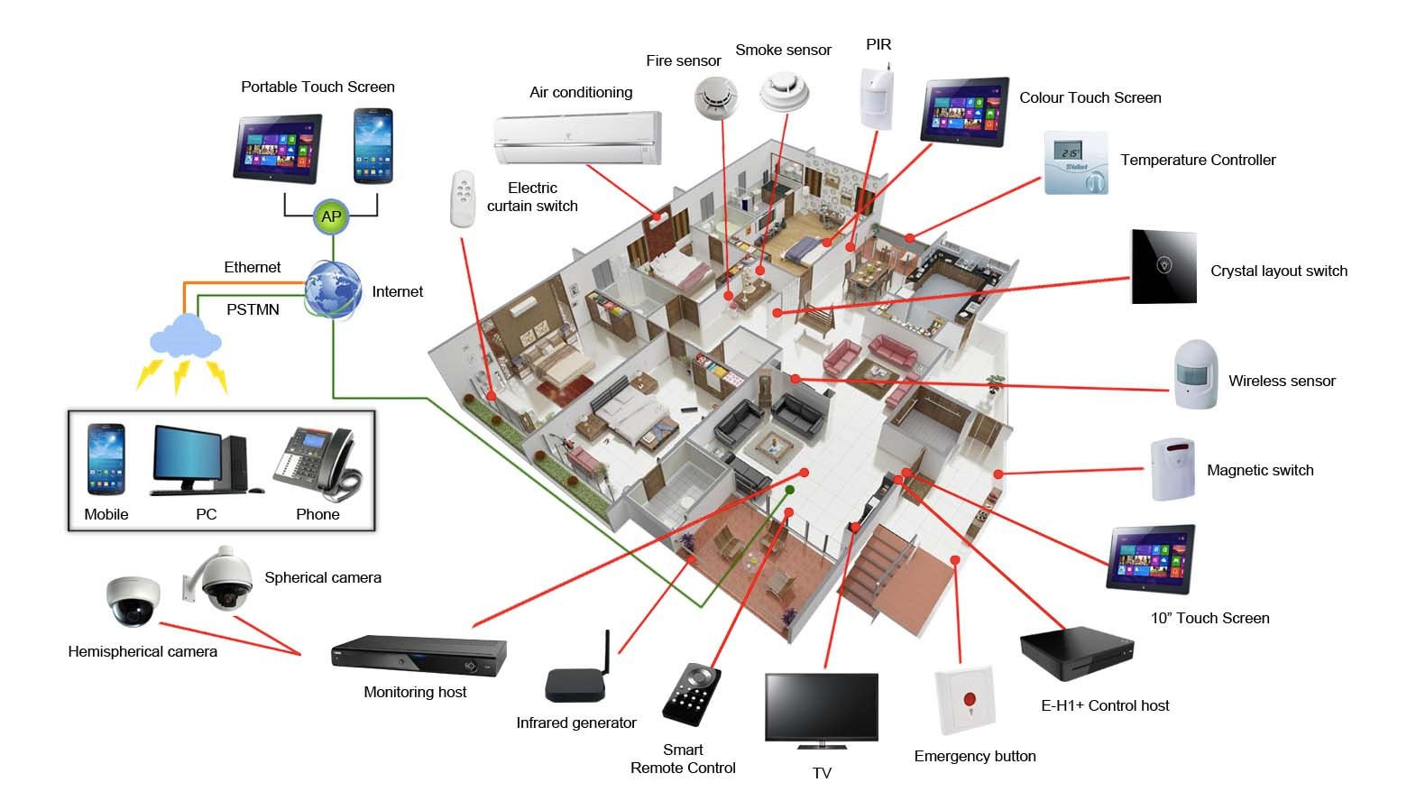
Smart Home Applications
Smart meters, hea1ng/cooling, mo1on/temperature/ ligh1ng sensors, smart appliances, security, etc.
35

Slide 48





A Futuristic Applica1on: Shopping
When entering the doors, scanners will iden1fy the tags on her clothing.
When shopping in the market, the goods will introduce themselves.
When paying for the goods, the microchip of the credit card will communicate with checkout reader.
When moving the goods, the reader will tell the staﬀ to put a new one.
36

